Slide 1

Playlist Creator
Olaru Laura-Elena
Roman Denisa-Bianca
Mentor: Scarlat Alin

Slide 2
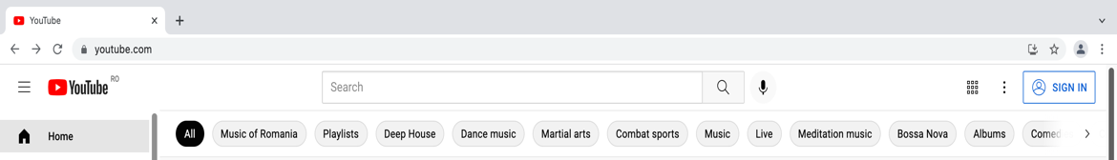
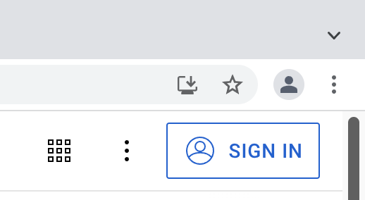
Login YouTube
1. Opens www.youtube.com.
4. Types into the Email or phone field the email.
6. Types into the password field the password.
2. If someone is already logged in, logs out and hits SIGN IN button.
3. Reads the credentials from Orchestrator’s assets.
5. Hits the Next button.
7. Hits the Next button.
Automation Steps

Slide 3
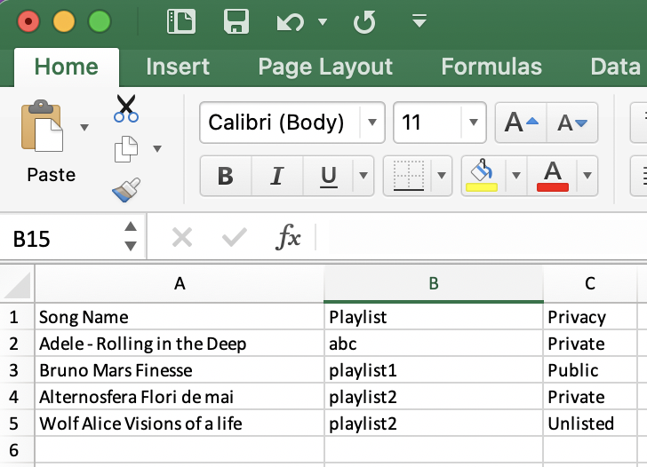
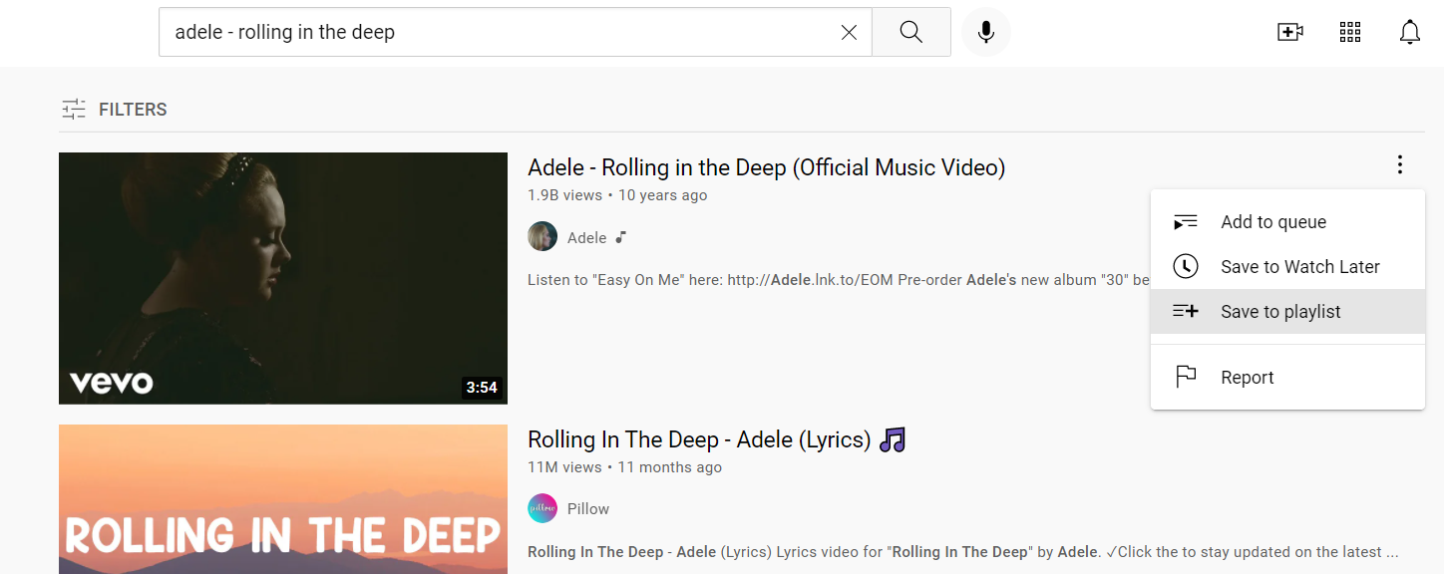
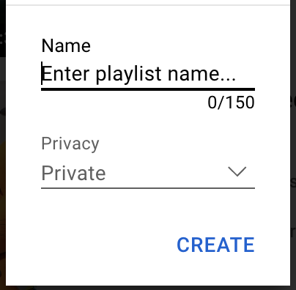
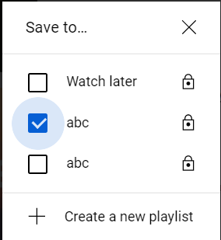

Create YouTube Playlists
1. Reads the songs, their playlists and their privacy from the Excel file.
3. Hits Options ( See red square ) on the first song and click “Save to playlist”.
5. Enters given playlist name and choses playlists privacy.
6. Hits Create.
4. Searches if the playlist name already exists.
If yes – ticks the checkbox.
If not – hits “Create new playlist”.
7. Repeats steps 4-6 for each song.
2. Types into search box the song name and hits search.
8. Prompts Message Dialog to confirm completion.
Automation Steps

Slide 4
Automation benefits
Transferring a playlist from another music application to an YouTube playlist
Saves time
Reduces repetitive tasks
Increases productivity

Slide 5
Robotic Enterprise Framework (REF) benefits
Automatic error handling
Config files
Well-structured application

Slide 6
Orchestrator benefits
User credentials in orchestrator’s assets provide:
security
easy modification

Slide 7
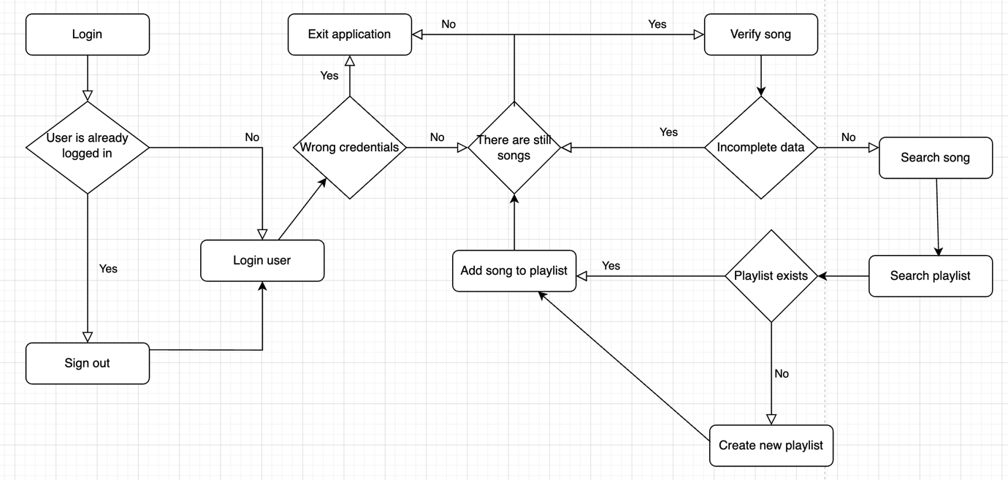
Solution diagram of the process

Slide 8
Thank you!

